Slide 1
CAR PRICE PREDICTION
Gizem & Başaran & 20SOFT1041

Slide 2
Content
Goal
Dataset Information
Data Mining Functions and Algorithms
Results
Prediction Examples

Slide 3
The Goal of the Study
Estimate the selling price of the vehicles with Linear Regression and Random Forest Algorithms.

Slide 4
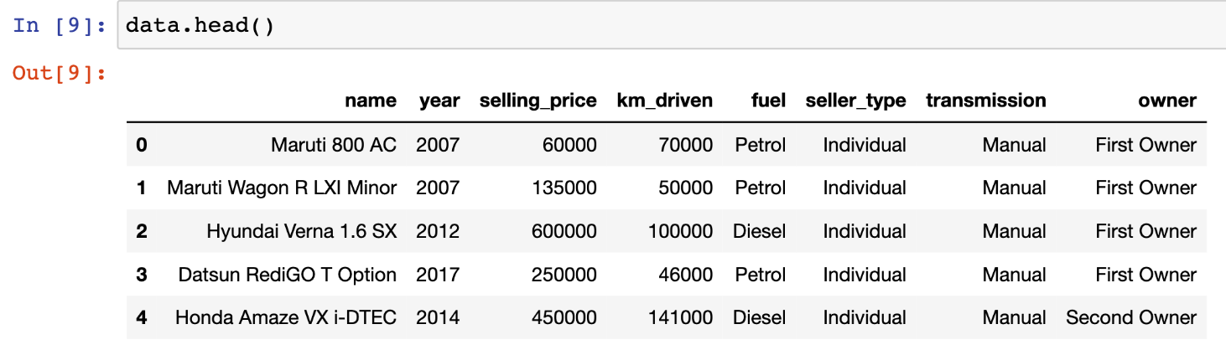
Dataset
Vehicle dataset has 8 attributes and 4340 instances.

Slide 5
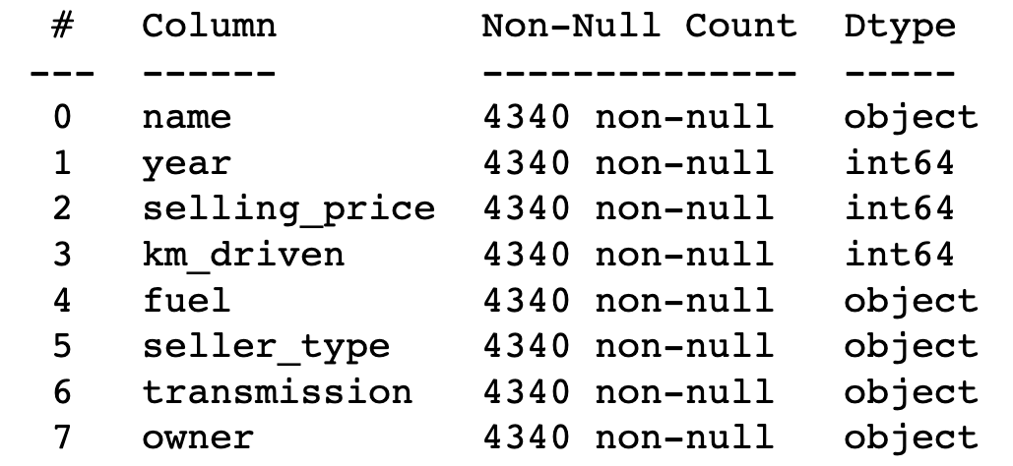
Data Mining Functions and Algorithms
I applied the algorithm I chose by choosing Classify and Random Forest from Weka. Then i applied Linear Regression using pandas, numpy, LinearRegression libraries using python.
I removed these object features to feature selection part; seller_type, owner, fuel, name, transmission.

Slide 6
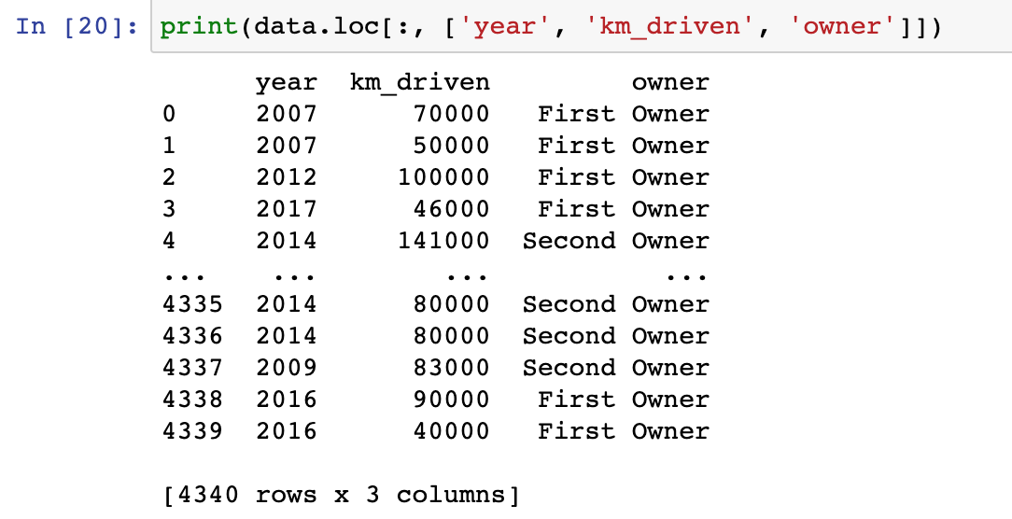
Results (Quality Measurements)
Quality measurements that may be relevant include the age of the car, the mileage, number of user and the functionality of the various systems and components. In my dataset quality measurements; year, km_driven, owner..

Slide 7
Results (Numeric)
Linear Regression: | Random Forest:
MAE: 0.9937753386731192 | MAE: 0.1468
MSE: 2.162871527787962 | MSE: 0.2866
RMSE: 1.4706704347976682 | RMSE: 0.5354
Accuracy: 85 % | Accuracy: 70 %

Slide 8
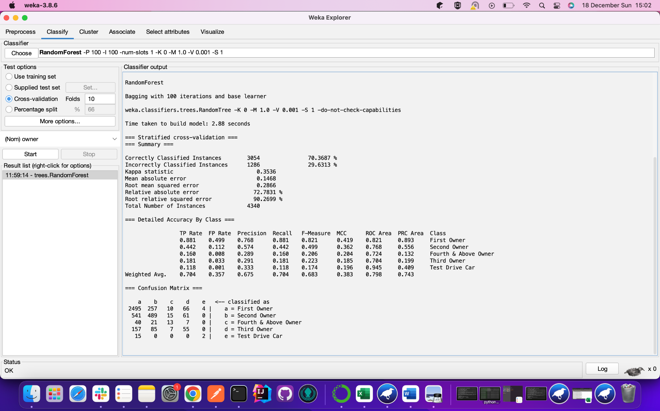
Random Forest Numeric Results in Weka

Slide 9
Confusion Matrix

Slide 10
Results (Interpretation)
Linear regression, the coefficients can provide information about the strength and direction of the relationship between each feature and the target variable.
random forests, can provide a measure of feature importance, which can indicate which features are the most important predictors of the target variable.
The accuracy of the model can give you an idea of how well the model is able to predict the target variable. You can use different evaluation metrics, such as mean absolute error or root mean squared error, to measure the accuracy of the model.

Slide 11
Prediction Examples
prediction: 366599.48, target value: [350000]
prediction: 502965.82, target value: [450000]
prediction: 1157524.28, target value: [930000]
prediction: 823426.73, target value: [685000]
prediction: 332507.89, target value: [325000]
prediction: 502965.82, target value: [450000]

Slide 12
THANKS FOR LISTENING

